Slide 1
DATA ANALYTICS PROJECT
Customer Behavior & Purchase Pattern Analysis
End-to-End Workflow — Python · MySQL · Power BI

Slide 2
Project at a Glance
233K
59.76
Total Volume
Avg Quantity
3,900 orders
Per purchase
4,000
26.88%
Customer Base
Subscribers
Unique users
63K share
Jupyter Notebook
MySQL Database
Power BI
Dataset
Project1.ipynb
Project1
Desktop
~3,900 records

Slide 3
Key Finding
Category Performance
Subscription Gap
Clothing leads with 104K in sales (3.40K interactions), followed by Accessories (74K) and Footwear (36K).
Non-subscribers drive 73.12% (170K) of total volume — a major conversion opportunity.

Slide 4




Data Preprocessing
JUPYTER NOTEBOOK · PROJECT1.IPYNB
Null & Rating Cleaning
Column Standardization
Missing values across ratings, shipping, discounts handled
snake_case formats for seamless SQL querying
Feature Binning
Type Formatting
Ages segmented: Young Adult, Adult, Middle Aged, Senior
Purchase volumes cast to numeric; binary flags standardized

Slide 5

SQL Queries 01–03
MYSQL WORKBENCH
Q1 · Gender Revenue Share
Q2 · Discount Sensitivity
Q3 · Product Ratings
High-value buyers using discounts above avg (59.76)
Top 5: Gloves (3.86), Sandals (3.84), Boots (3.82), Hat (3.80), Skirt (3.78)
Revenue distribution by gender for targeted marketing

Slide 6
SQL Queries 04–06
Q4 · Shipping Comparison
Q5 · Subscription Impact
Q6 · Discount Reliance
Non-subscribers: 170K vs. subscribers: 63K — primary growth lever
Top 5 products by discount purchase % — promotional dependency
Avg purchase: Standard vs. Express — basket size correlation

Slide 7


SQL Queries 07–10
Q7 · Customer Segmentation
Q8 · Category Top Performers
New, Returning, Loyal cohorts via previous purchases
Top 3 best-sellers per category using window functions
Q9 · Repeat Buyer Subscription
Q10 · Demographic Contribution
Subscription conversion among buyers with >5 orders
Revenue by age group: Young Adult, Adult, Middle Aged, Senior

Slide 8
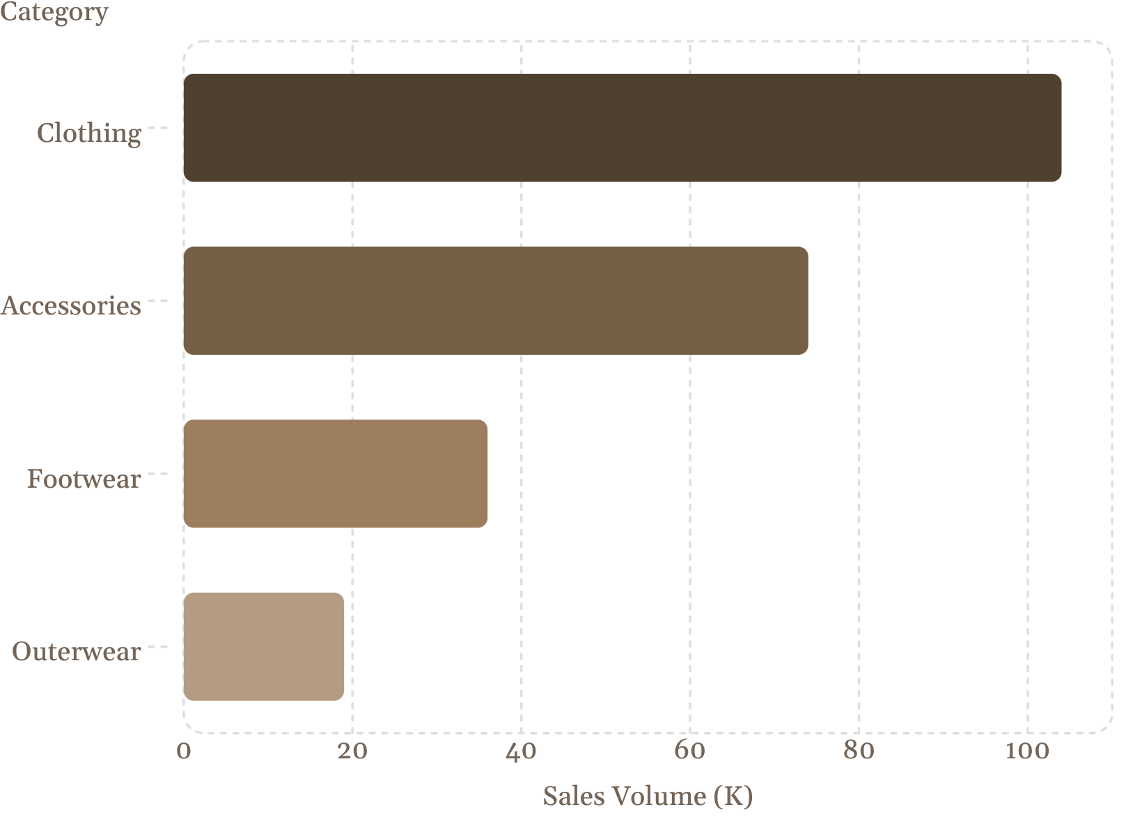
Dashboard Insights
POWER BI
Sales by Category
Clothing dominates at 104K. Customer interactions: Clothing 3.40M, Accessories 2.41M, Footwear 1.17M, Outerwear 0.62M.
Review Ratings
Consistently high — led by Gloves (3.86), Sandals (3.84), Boots (3.82), Hat (3.80).

Slide 9
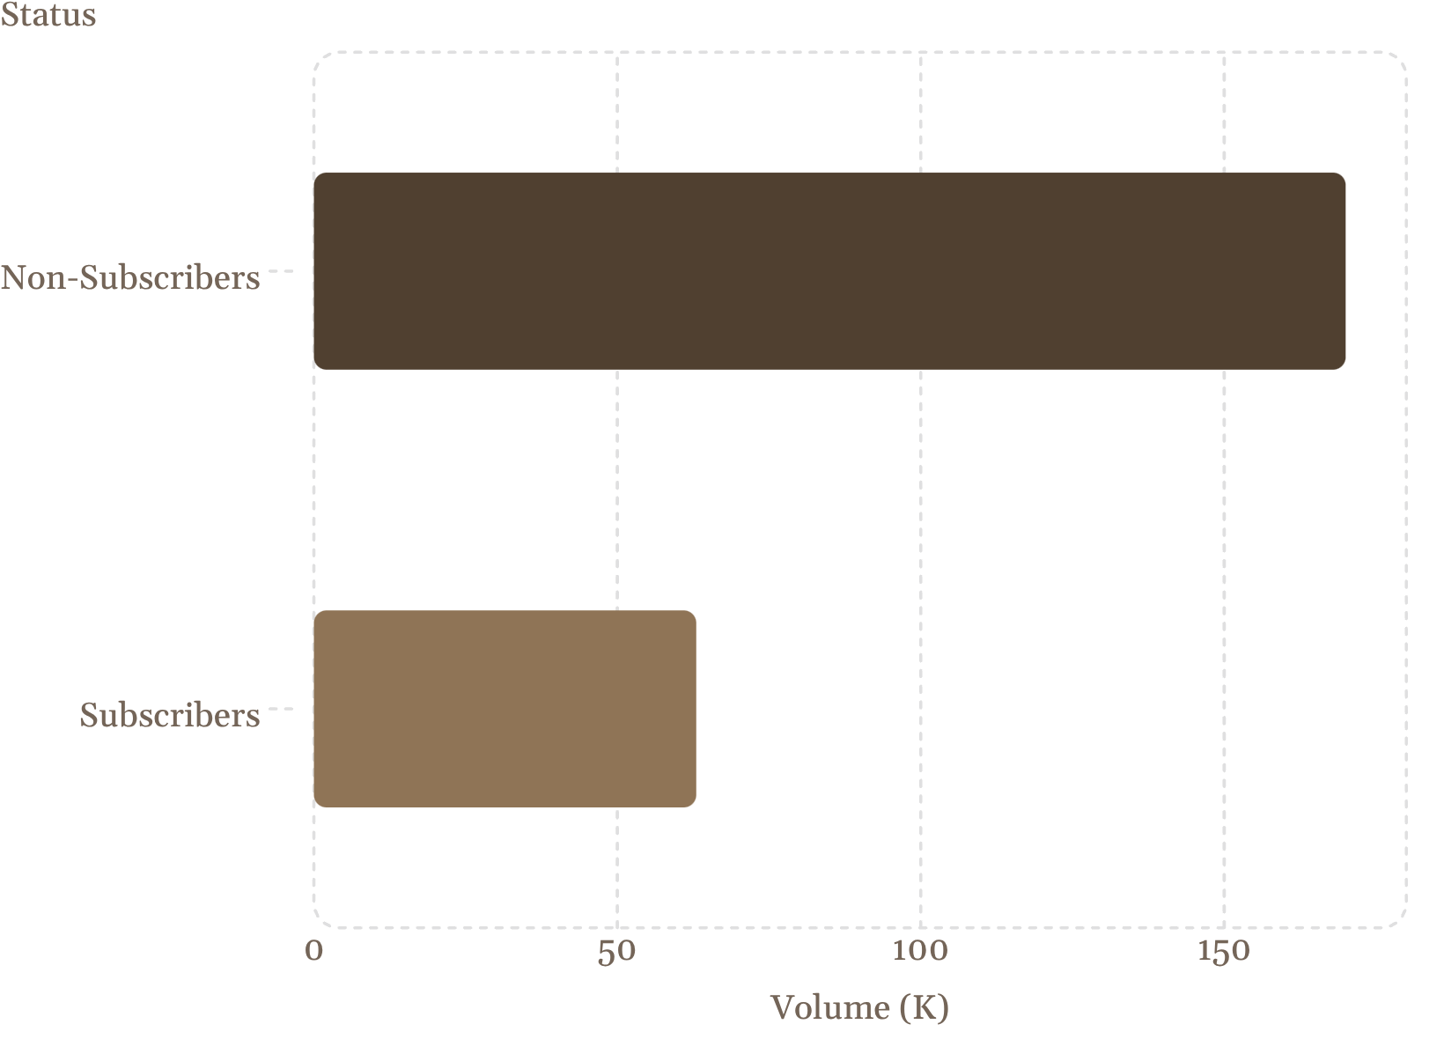
Subscription Breakdown
73.12% Non-Subscribers
170K of 233K total volume comes from non-subscribers — the primary conversion opportunity.
26.88% Subscribers
Only 63K from subscribed users, despite higher engagement potential.

Slide 10
Recommendations
1
Subscription Conversion Push
2
Double Down on Top Categories
3
Minimum Spend Thresholds
Target repeat buyers (>5 orders) with exclusive subscriber perks
Prioritize Clothing (104K) and Accessories (74K) in inventory and placement
Shift discount users above avg (59.76) to threshold promos — e.g., "10 off orders over 75"

